Slide 1

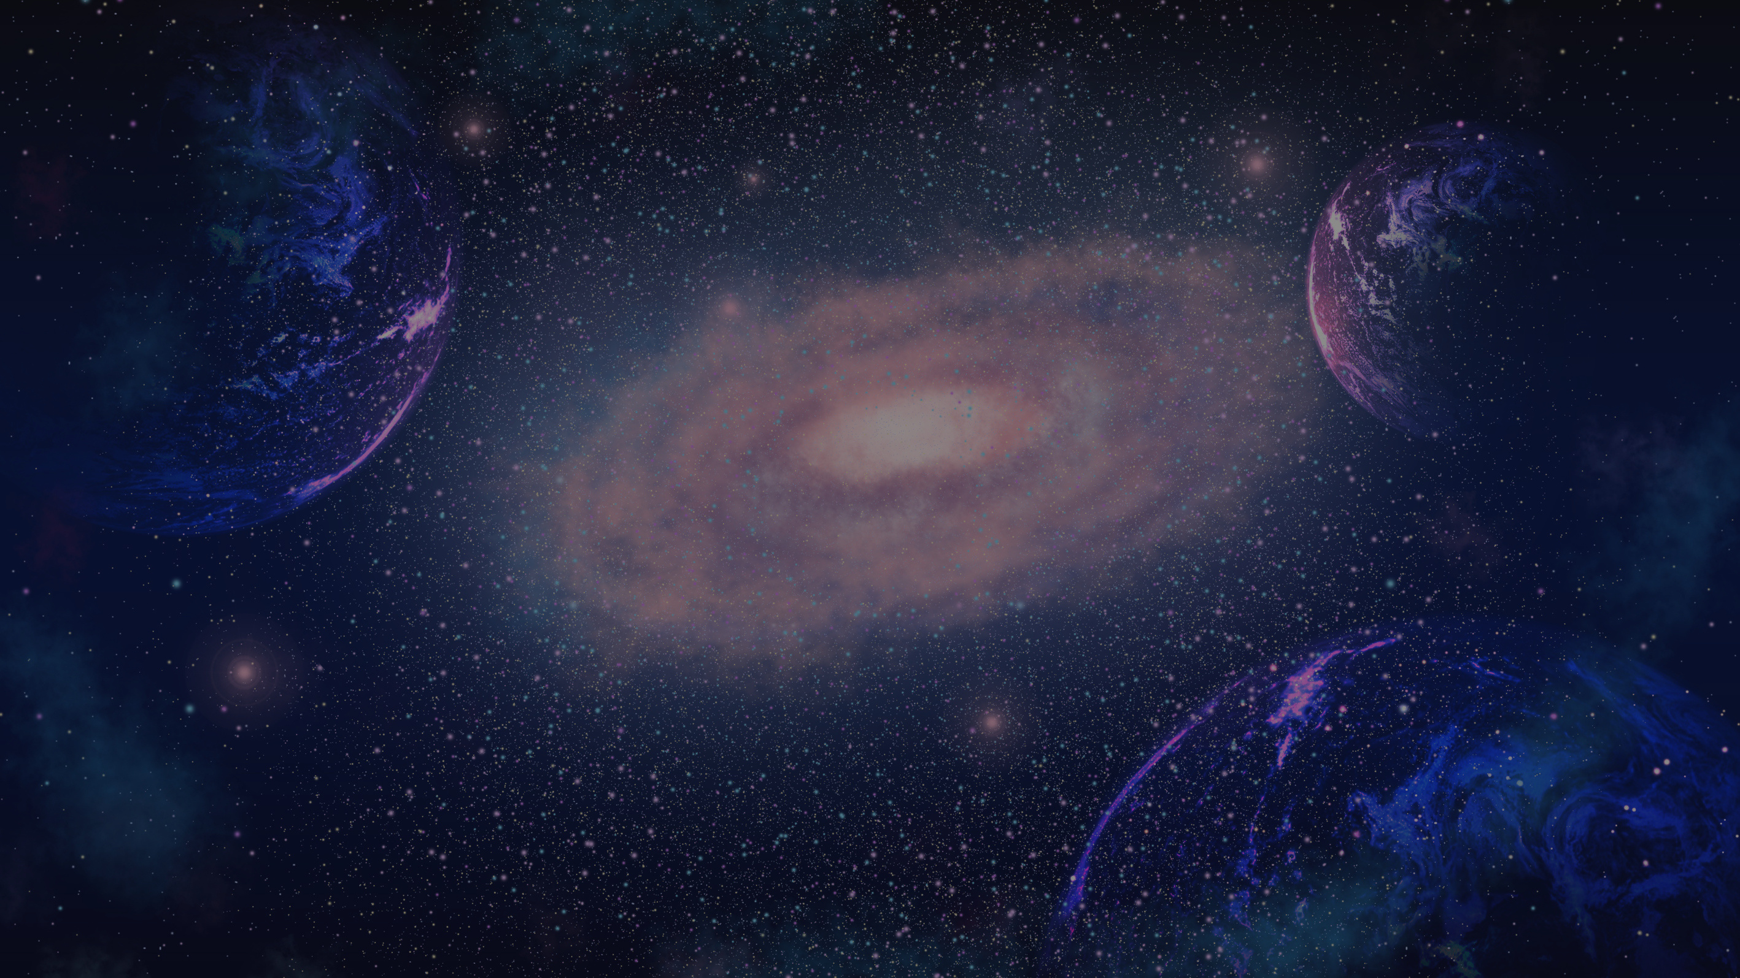

EARTH TODAY
See the earth. Reflect. Reconnect. Repeat.
TEAM
Anirudh Pratap Singh Yadav
Lakshmi Srujana
Symbiosis Institute of Technology, Hyderabad
INSTITUTE

Slide 2

THE PROBLEM
we’re surrounded by the space, but disconnected from it
The universe is vast, beautiful, and in motion every second
Nasa collects incredible real time data - from breathtaking space imagery to planetary to Earth observatories - and it’s all publicly available.
Yet, most people never interact with it. It stays locked away in APIs, websites, and dashboards that feel out of reach or too technical.
The problem isn’t lack of data.
It’s lack of emotional connection to that data - and we aim to bridge that gap using NASA’s rich ecosystem of APIs.

Slide 3
THE SOLUTION
A web application that brings daily NASA data to the everyday person - as a space powered mindfulness tool.
With EARTH TODAY, users can :
See Astronomy Picture of the day
Satellites orbiting Earth
World Clock

Slide 4
WHY NASA API ??
NASA’s API offers :
Space Imagery
Real - time planetary and satellite data
Historical archives
Scientific insights made accesible

Slide 5
API AND ENDPOINTS USED
https://api.nasa.gov/
What we get from the API ??
Daily space image or video
Title and explanation of the content
Date of capture/publication

Slide 6


FEATURE LIST
Astronomy Picture of the Day
View NASA’s daily space image with description.
Learn about cosmic phenomena in a simple, beautiful format.
Live Satellite Tracker
View real - time positions of satellites orbiting Earth
Interactive satellite map with user location support.
World Clock Integration
See current time across different continents and cities.
Visualize global daylight zones

Slide 7

USE CASE SCENARIOS
Mindfulness Seekers
Use APOD as a daily reflection tool
Space Enthusiasts
Track satellites and explore orbital data
Global Professionals
Use the world clock for remote collaboration
Students & Educators
Learn astronomy through daily, real - time content

Slide 8
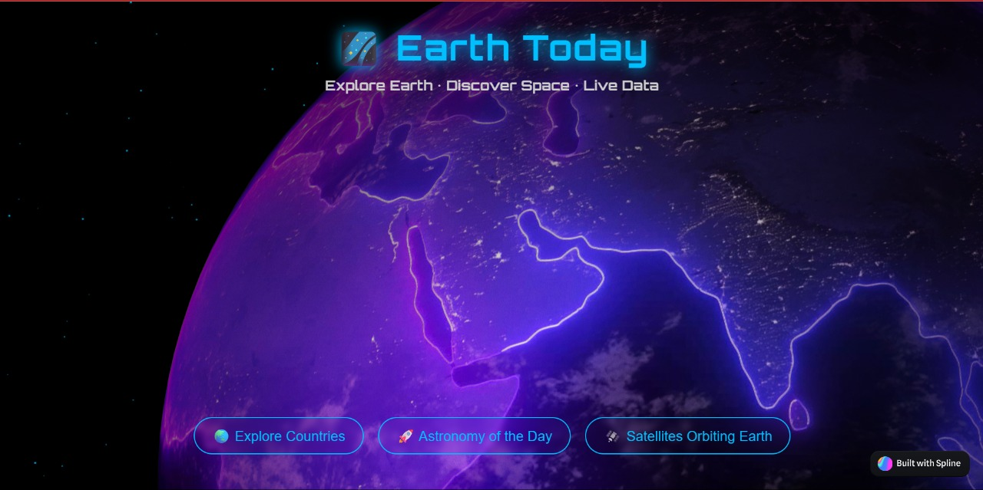

EARLY WORKING PROTOTYPE
Repo link :
Earth Today

Slide 9
FUTURE SCOPE
what’s next for Earth Today ?
Mood - Based APOD Suggestions
Use AI to match Astronomy Picture of the Day with user moods, music or quotes.
Real - Time Satellite Alerts
Notify users when major satellites like the ISS are visible above their location.
Space Calendar
Scroll through past APODs, satellite movements, and personal reflections in a visual calendar format.
Global Space Events Layer
Integrate celestial events like eclipses, meteor showers, and satellite launches directly into the dashboard.

Slide 10

THANK
YOU

